Slide 1

Online Quiz Web Application
Project Supervisor: Mr. Amandeep Singh K
Name of the Student: Bandepalli Surya Anjani Kumar
Register Number: 40110156
7 November 2022
Department of CSE
1

Slide 2
Presentation Outline
Course Certificate
Introduction
Objectives
System Architecture / Ideation Map
Module Implementation
Application Snapshots
Results and Discussions
Conclusion & Future work
References
7 November 2022
Department of CSE
2

Slide 3
Course Certificate

Slide 4

Introduction
There are several ways to educate and reinforce what we have learned in the realm of education.
Quizzes are an increasingly popular resource, particularly in online education.
Quizzes force your brain to retrieve data ensuring that it becomes "embedded" for use in the future.
7 November 2022
Department of CSE
4

Slide 5

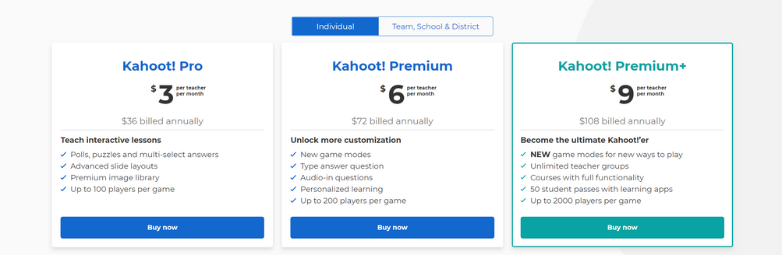
Existing System
Some educational institutions still conduct tests utilizing pen and paper.
There are quiz applications that employ cookies to direct users to their paid subscription plans.
A quiz app that is responsive and open-source was found to be necessary.
7 November 2022
Department of CSE
5

Slide 6

Objectives
PROPOSED SYSTEM:
To Develop a Quiz Web-App which is:
Responsive
Open-Source
Dynamic
Feature-Rich
Stores Data
Prevents Malpractice (Order Randomizer, Tab-Switch Prevention, Off-Focus Warning)
User-Friendly
7 November 2022
Department of CSE
6

Slide 7
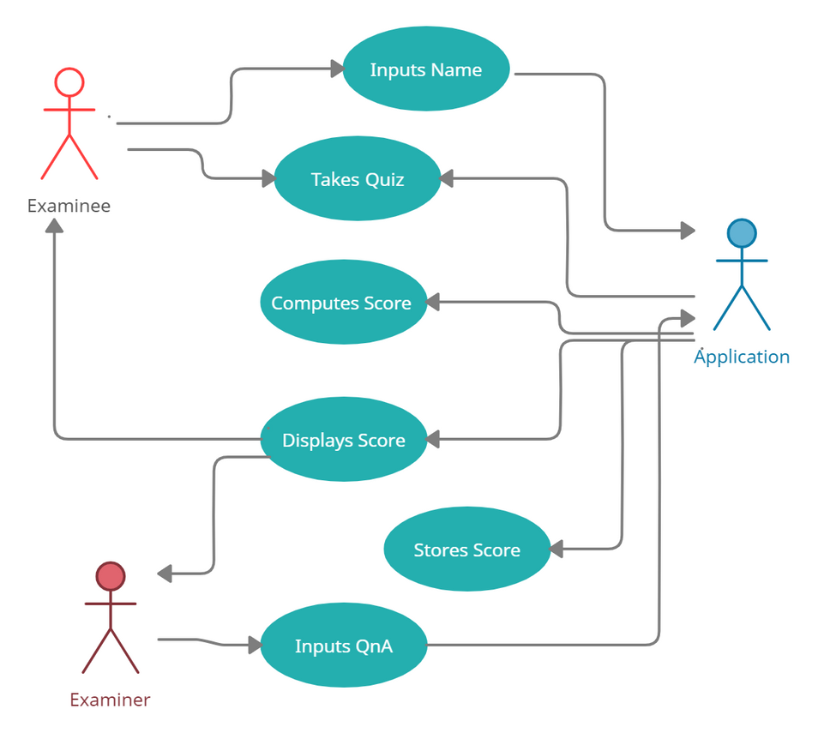
System Architecture
Use Case Diagram
7 November 2022
Department of CSE
7

Slide 8

Project Implementation
Front-End (Client-Side)
HTML5
CSS3
Bootstrap 4
JavaScript ES6
jQuery
7 November 2022
Department of CSE
7

Slide 9


Project Implementation (Ctd.)
Back-End (Server-Side)
NodeJS (NPM)
ExpressJS
MongoDB
Mongoose
Deployment
Heroku
7 November 2022
Department of CSE
7

Slide 10
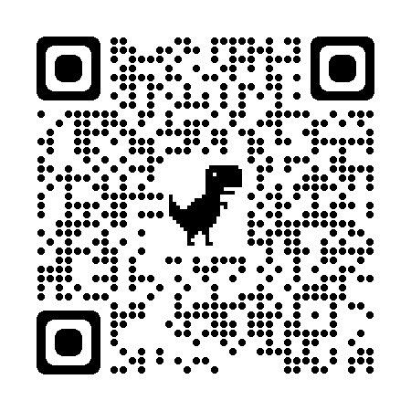
Deployment Link
quick-quizizz.herokuapp.com
7 November 2022
Department of CSE
7

Slide 11

User Requirements
Hardware Requirements:
CPU: Intel Pentium 4 or later
RAM: 2 GB or higher
Storage: 2 GB available space recommended
Internet Connection: Required
Software Requirements:
The latest version of any Browser
(Chrome Recommended)

Slide 12
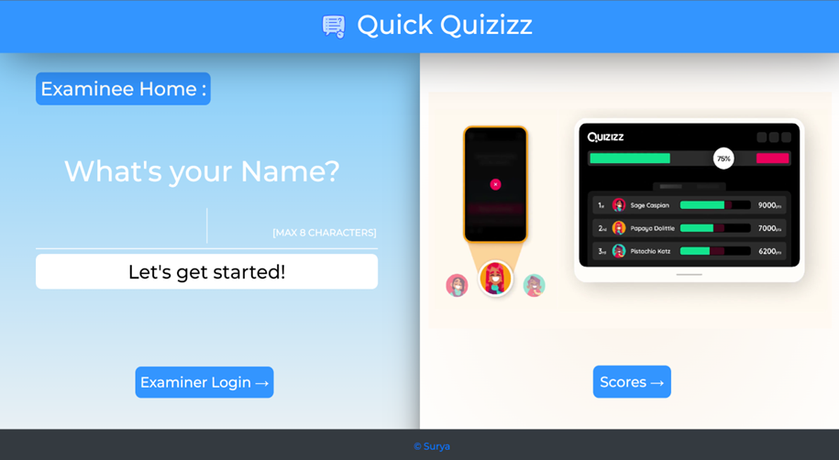
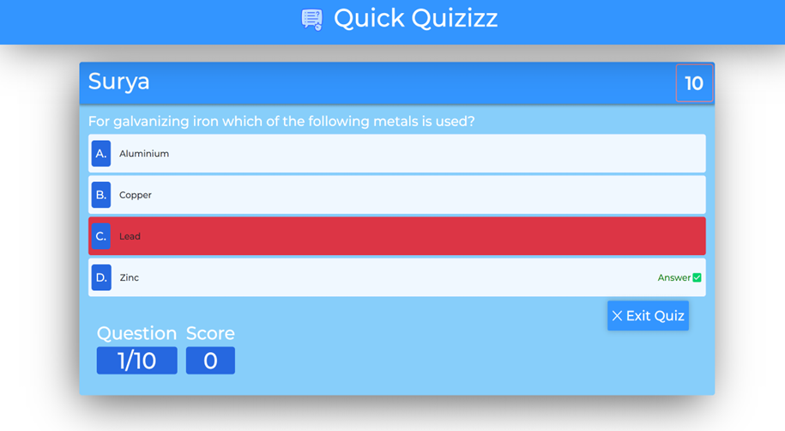

Sample Snapshot / Ideation Map
Examinee:
Home Page
Quiz Page
7 November 2022
Department of CSE
8

Slide 13
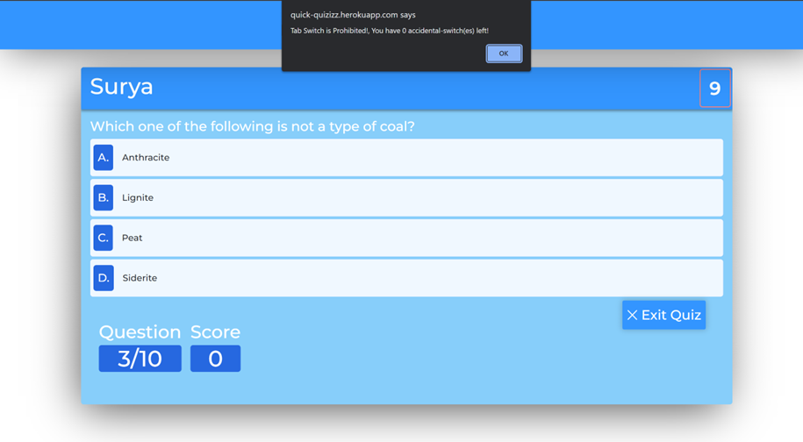
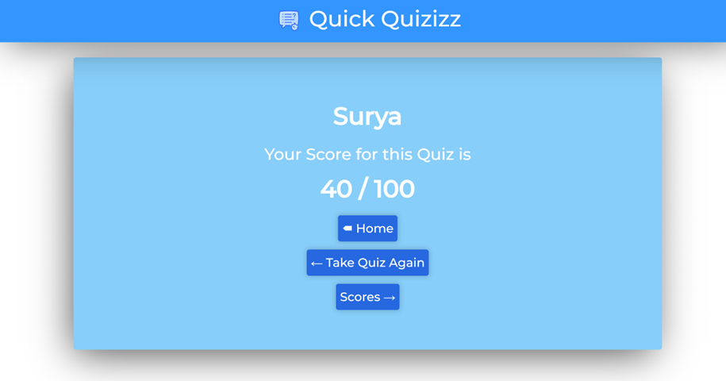
Sample Snapshot / Ideation Map
Quiz-End Page
Tab-Switch Warning
7 November 2022
Department of CSE
8

Slide 14
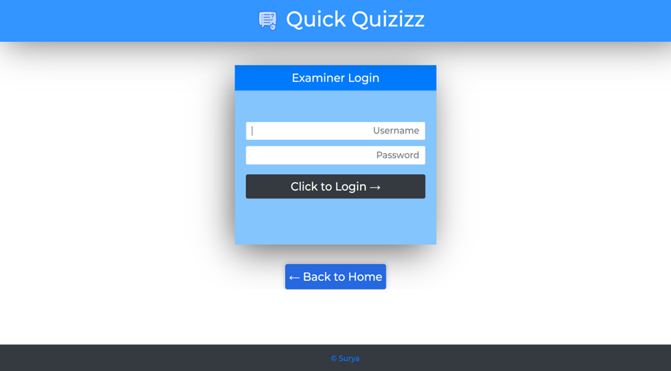
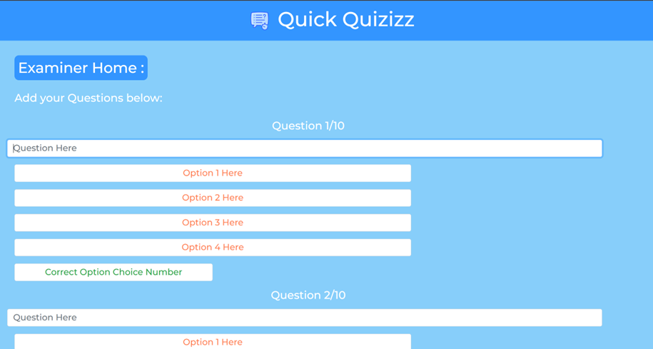
Sample Snapshot / Ideation Map
Examiner:
Examiner Login
Questions' Adder
7 November 2022
Department of CSE
8

Slide 15
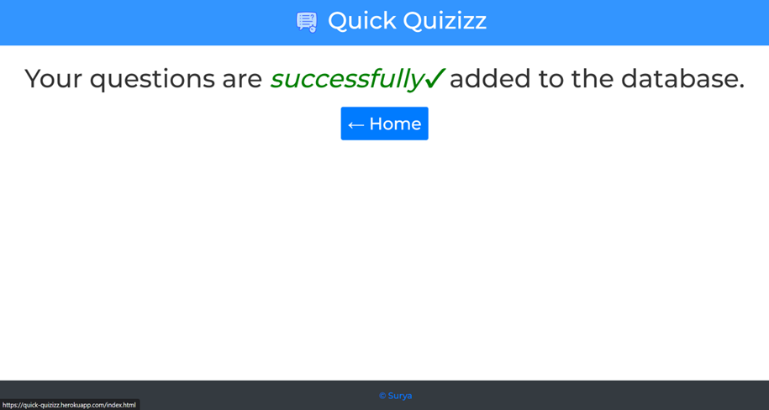
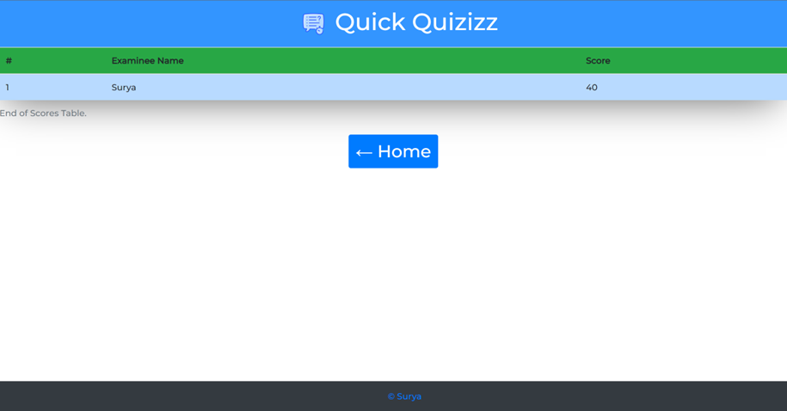
Sample Snapshot / Ideation Map
Success Acknowledgement
Scores Page
7 November 2022
Department of CSE
8

Slide 16

Conclusion
The best efforts were made to develop a web application with as less bugs as possible.
To keep up with the latest trends, the project will be iteratively improved.
In the future, the project will develop to include features like
A dashboard for Teachers
Student focus checker using machine learning and
Support for multiple quizzes.
7 November 2022
Department of CSE
10

Slide 17
References
Angela Yu, Web-Development Bootcamp, The App Brewery,
https://www.udemy.com/course/the-complete-web-development-bootcamp/
Mosh, The Ultimate HTML/CSS Mastery Series
https://codewithmosh.com/p/the-ultimate-html-css
Documentation, Mongoose
https://mongoosejs.com/docs/api/document.html
Heroku Dev Center, Heroku
https://devcenter.heroku.com/categories/reference
Richard Kalehoff, Version Control with Git
https://www.udacity.com/course/version-control-with-git--ud123
GitHub Repository
https:/github.com/Surya-Kumar-03/Quick-Quizizz
7 November 2022
Department of CSE
11

Slide 18
THANK YOU!
7 November 2022
Department of CSE
12

